Slide 1
Roadmap: SD-WAN Gen 2 to Gen 3 Evolution
For Review by Infrastructure, Security, Operations Leadership and ARB

Slide 2
Agenda
1. Context: Why Modernize WAN Architecture
2. SD-WAN Gen 2 – Current State
3. SD-WAN Gen 3 – Target State
4. Day 0–2 Transformation Plan
5. Migration Checklist & Risk Overview
6. Key Recommendations & Next Steps

Slide 3
Why Modernize SD-WAN Now?
Increased SaaS, IaaS, and remote work adoption
Centralized backhaul model adds latency & cost
ZTNA and SSE adoption demand cloud-first connectivity
Cloud Exchanges and DIA reduce dependency on MPLS

Slide 4
SD-WAN Gen 2 – Scenario 2
Hub-and-spoke with centralized egress
MPLS + Internet hybrid underlay
Perimeter firewall-centric security
Limited cloud/SaaS optimization
Complex operational model with static routing

Slide 5
SD-WAN Gen 3 – Scenario 3
Distributed, identity-aware access model
Cloud-native routing + SSE inline enforcement
Metro breakout + cloud exchange optimization
ZTNA for users; SWG + CASB for SaaS
IaC, observability, and continuous compliance

Slide 6
Day 0–2 Transformation Plan
Day 0: Assess, Design, Select SSE vendor, Update Landing Zones
Day 1: Deploy SSE PoPs, ZTNA clients, SD-WAN routing policies
Day 2: Automate policies, monitor performance, phase out MPLS

Slide 7
Migration Checklist (Sample)
Pre-reqs: SSE vendor selected, IAM integrated, DIA enabled
Owners: Network Eng (infra), CyberSec (ZTNA/SWG), CloudOps (Landing Zones)
Risks: Latency shifts, misrouting, ZTNA auth gaps, policy drift
KPIs: Access latency, tunnel success rate, SaaS block violations

Slide 8
Key Recommendations
Finalize SSE vendor and PoP rollout plan
Pilot metro DIA breakout + ZTNA flows
Define SD-WAN & SSE integrated policies
Present business case to ARB board
Plan phased MPLS retirement per site group

Slide 9
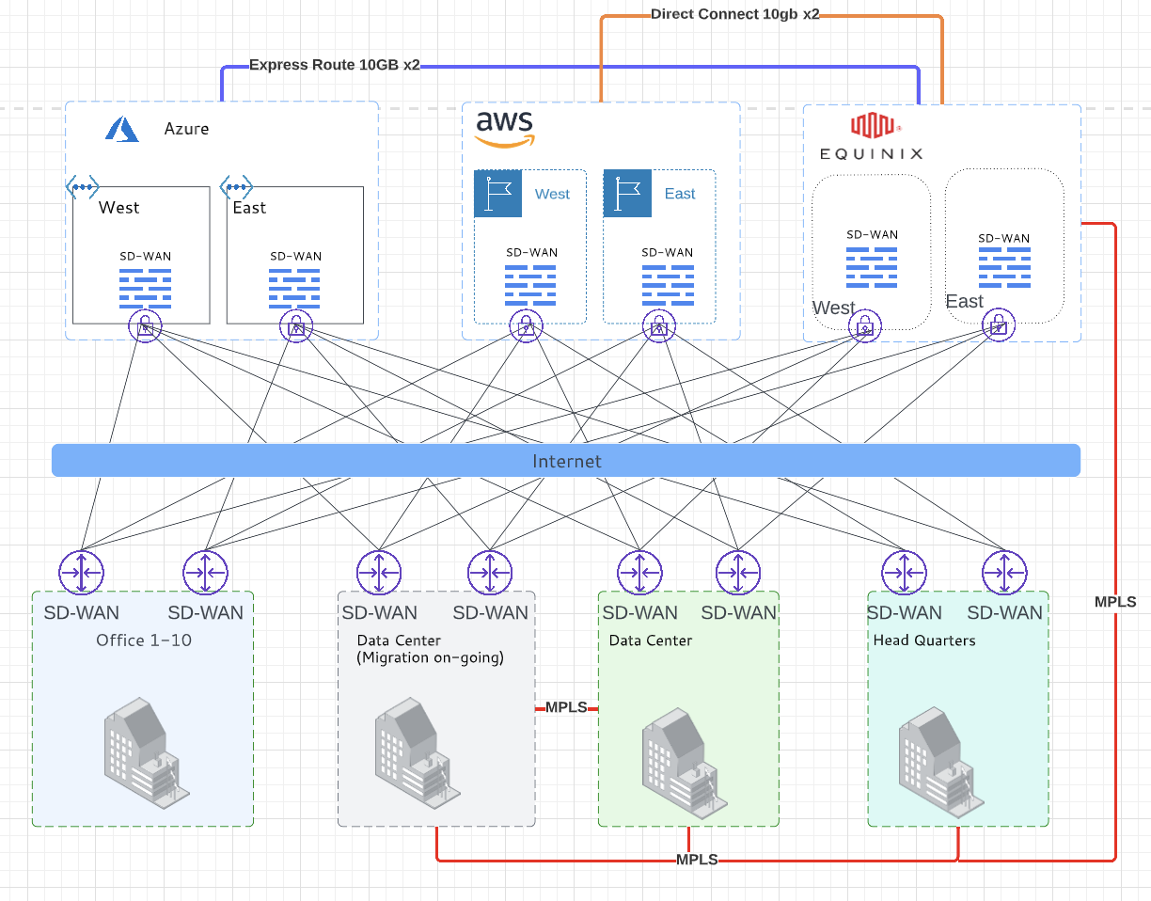
SD-WAN Gen 2 Pattern - Classic overengineered network

Slide 10
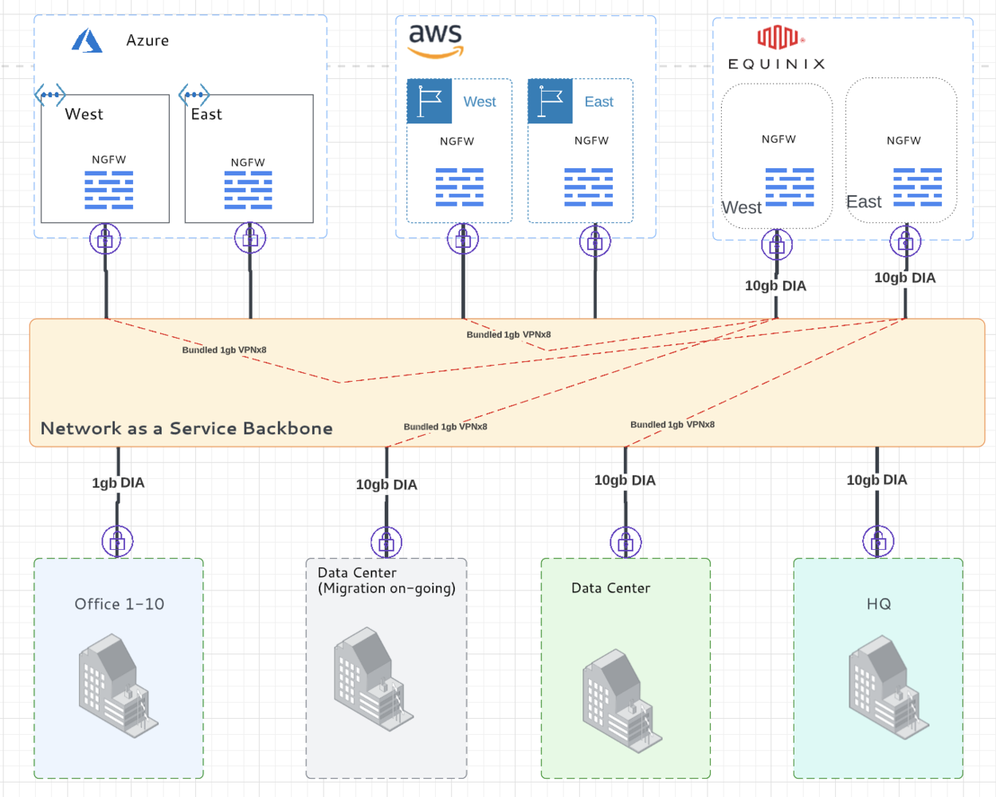
SD-WAN Gen 3 Pattern - Network as a Service

